Slide 1
Brief Introduction to bupaR Packages Dominic Rowney – dominic.rowney@nhs.net

Slide 2
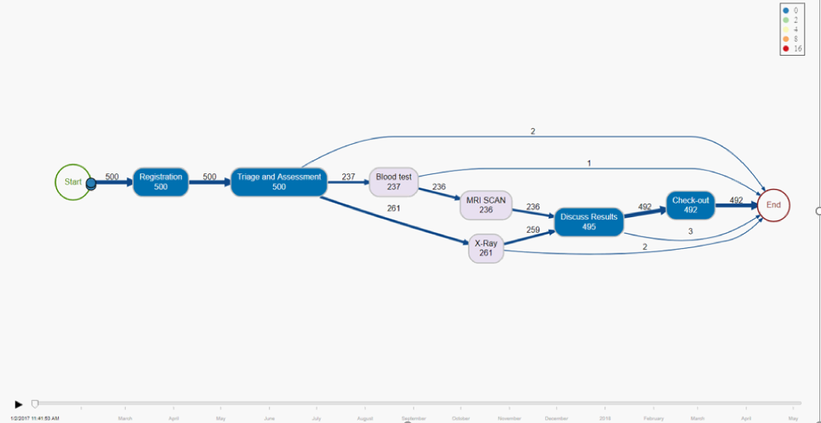
Animation
Vignette: User defined bins for time to change token aesthetics

Slide 3

Outline
business process analysis in R
Engaging visuals
Structure of data to allow other modelling
Explore patient journeys
Other applications e.g. pathways through a website, production flow, continuous improvement
%>%
Ceci n'est pas une pipe
This presentation assumes some understanding of basic tidyverse functions

Slide 4
Structure of an event log
Path or
Trace
Event 1
Path or
Trace
Start
Schedule
Complete
Start
End
Event 2
Event 3
Activity
Start
Complete
Start
Complete
Uses a Resource

Slide 5
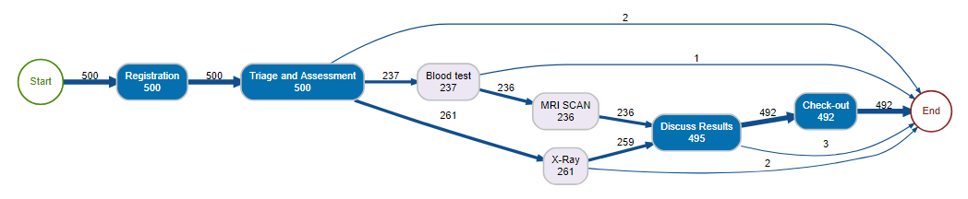



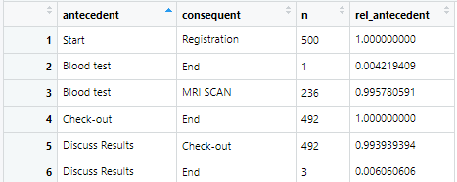
Summary of the Process
ID | t1 | t2 | t3
A
B
RODBC
Demand
and
Capacity
ID | Activity | Event | t
A | 1 | Start
A | 1 | Finish
A | 2 | Start
A | 2 | Finish
B | 1 | Start
B | 1 | Finish
B | 2 | Start
B | 2 | Finish
SQL
Precedence Matrix

Slide 6
Data Wrangling - R
I did data heavy lifting in SQL (you could use R, Excel, etc.)
Load data into R (I used RODBC package)
# Libraries ---------------------------------------
library(tidyverse) ## tidy data, pipes, etc.
library(bupaR) ## business process analytics
library(processanimateR) ## animates business process
library(RODBC) ## ODBC connection
RODBC
SQL

Slide 7
Data Wrangling - R
Load data into R (I used RODBC package)
mutate data types, eventlog() is particular
## change data types --------------------------------
my_data <- my_data %>% mutate(
case_id = as.character(case_id)
, activity_id = as.character(activity_id)
, timestamp = as_datetime(timestamp)
, lifecycle_id = factor(lifecycle_id)
, activity_instance_id = factor(activity_instance_id)
, resource_id = factor(resource_id) %>%
fct_explicit_na("n/a")
, .order = as.integer(activity_instance_id)
)

Slide 8
Data Wrangling - R
Load data into R (I used RODBC package)
mutate data types, eventlog() is particular
Put data into a tibble which is sorted by .order
## make into an ordered tibble -----------------------
my_data <- my_data %>%
as_tibble() %>%
arrange(.order)

Slide 9
Data Wrangling - R
mutate data types, eventlog() is particular
Create an event log using eventlog()
## create event log --------------------------------
my_events <- my_data %>% eventlog(
case_id = "case_id"
, activity_id = "activity_id"
, activity_instance_id = "activity_instance_id"
, lifecycle_id = "lifecycle_id"
, timestamp = "timestamp"
, resource_id = "resource_id"
, order = ".order“ ## not required
, validate = TRUE ## faster without validation)

Slide 10
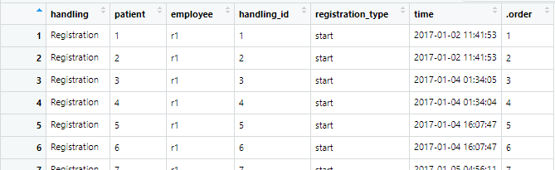
Example Data
Look at the eventlog patients from the package
patients %>% View()

Slide 11
Process Maps
Easy to produce a diagram using process_map()
patients %>% process_map()

Slide 12
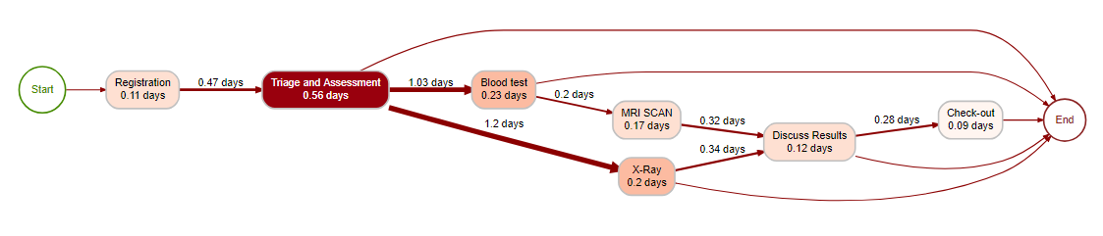
Performance Maps
Easy to produce a diagram using process_map()
patients %>% process_map(performance(median, "days"))

Slide 13
Precedence Matrix
I used the relative antecedent transitions as the basis of a demand and capacity model
patients %>%
precedence_matrix("relative-antecedent") %>% View()

Slide 14
Summary of the Process
ID | t1 | t2 | t3
A
B
RODBC
Demand
and
Capacity
ID | Activity | Event | t
A | 1 | Start
A | 1 | Finish
A | 2 | Start
A | 2 | Finish
B | 1 | Start
B | 1 | Finish
B | 2 | Start
B | 2 | Finish
SQL
Precedence Matrix

Slide 15
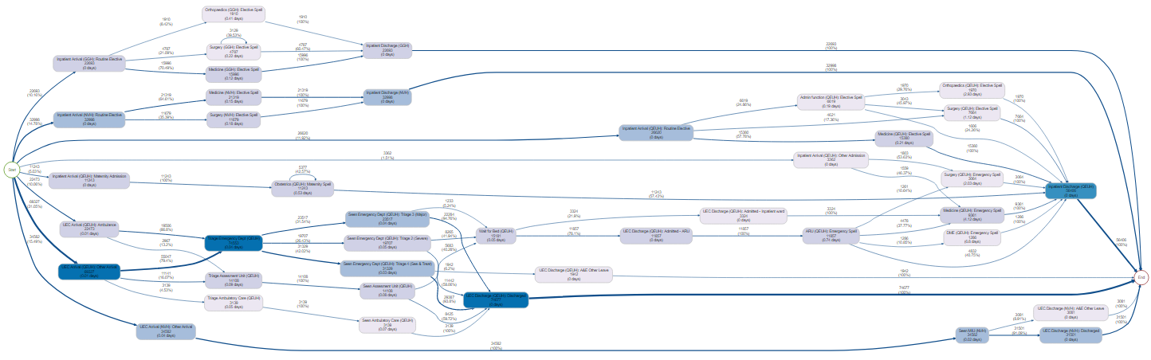
Case Study
I used the relative antecedent transitions as the basis of a demand and capacity model
Compare with qualitative data gathered by colleagues on the ground

Slide 16
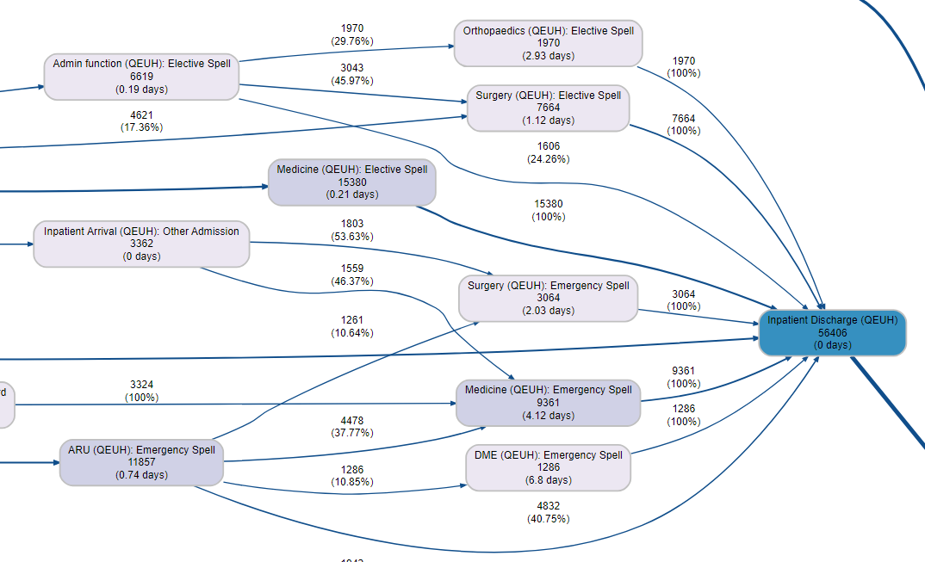
Case Study
I used the relative antecedent transitions as the basis of a demand and capacity model
Compare with qualitative data gathered by colleagues on the ground

Slide 17
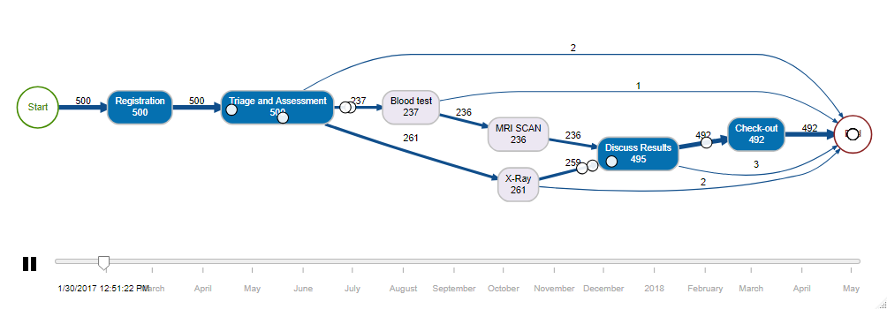
Back to the Animation
Easy to produce a diagram using animate_process()
For the intro animation see the vignette: User defined bins for time to change token aesthetics
patients %>% animate_process()

Slide 18
Other Tools
Manipulating, aggregating, editing and other functions for working with event logs
Resource maps
Other visualisations e.g. dotted chart
In-built R-Shiny dashboards
Explore bupar.net
patients %>% dotted_chart(x = "relative"
,y = "duration")

Slide 19


Dominic Rowney
dominic.rowney@nhs.net
Support from
Gert Janssenswillen
Felix Mannhardt
References
bupar.net
Thank you

